Slide 1
Lab 2 Introduction Powerpoint
What the Lab Teaches You
What the Intro Teaches You
Use the read.csv() function to import your data
Make a basic scatterplot using plot()
Perform simple column math to make a new column
Modify basic aesthetics of scatterplots and histograms like color, bin size, and point type
Create, modify, and save scripts
Tips on how to write “sentences” in R
Tips on avoiding common mistakes
What a # does, and other R script tricks

Slide 2

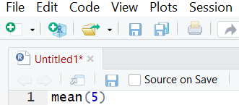

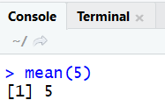
A Sentence in R
Basic Grammar in R
When you work with R, you're having a very boring conversation with an incredible literalist about statistics and data.
To have a full conversation, you must have an action word aka a verb (function) and something to do that action on, aka a noun (object). Example:
mean(5)
EXTREMELY INTERESTING EXAMPLE CONVERSATION
R, what is the average of the number 5?
Type into script window
Hit RUN
THE MEAN OF 5 IS 5
Returns answer in console window

Slide 3
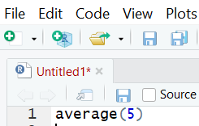
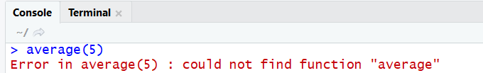
A Sentence in R
R can be very, very picky about your grammar and also your spelling. It also has a limited vocabulary.
For example, the function in R to get an average is called mean(). If you call it ANYTHING ELSE, R stares at you blankly.
EXTREMELY FRUSTRATING EXAMPLE CONVERSATION
R, what is the average of the number 5?
Type into script window
Hit RUN
OMG R U DRUNK
WHAT IS AVERAGE
LOL NO
Returns answer in console window

Slide 4
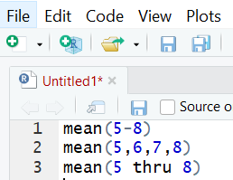
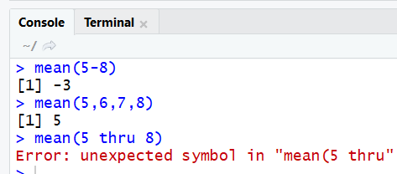
A Sentence in R
R can be very, very picky about your grammar and also your spelling.
But sometimes, it lets you sneak things through and gives you a weird answer
Also, its error messages? Not that informative.
EXTREMELY FRUSTRATING EXAMPLE CONVERSATION
What’s the average of the numbers 5,6,7 and 8?
Type into script window
Hit RUN
OMG FOR REAL IDEK WHAT U WANT
Returns answer in console window

Slide 5
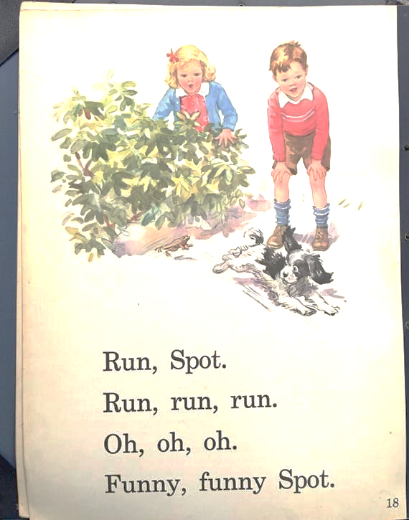
A Sentence in R
So the most basic sentence in R is constructed with a verb (function) and a noun (object), ie:
hist(metal$formed)
But you can also make more interesting sentences by adding the R equivalent of adjectives.
Like instead of saying “Run, Spot” you could say “Run Fast, Spot” or “Run On Two Legs, Spot” or something similar.
An adjective in R is called an argument, which is often set to a character string. You must separate arguments with a comma.
hist(metal$formed, col = "blue")

Slide 6


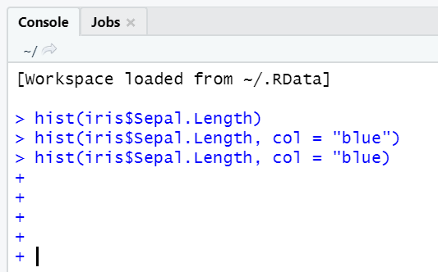

Common Mistakes in This Lab
Unpaired Quotations or Parentheses
Think of parentheses and quotations like a summoning circle for a demon.
If you don’t have a fully closed circle, your demon is loose and havoc reigns until you can wrestle it back under control
Symptoms include:
“unexpected symbol” error messages
Blue plus sign of death
Nothing else is running, plots aren’t showing up
Treatment:
Click in the console and hit escape to control the blue plus sign. Find your unpaired quotation or parenthesis, and fix it

Slide 7
Common Mistakes in This Lab
Arguments not Separated By Comma
Symptoms include:
“unexpected symbol” error messages
Function will not run
Other functions are not impacted
If your arguments are not separated by a comma, R thinks that they should be smooshed together and doesn’t fully understand what that sentence means.
Treatment:
The last argument in the error message should be near the missing comma, use this to find your comma placement.

Slide 8

Common Mistakes in This Lab
Curly Quotations
Symptoms include:
“unexpected input” error messages
Function will not run
Other functions are not impacted
If you copy-paste directly from Microsoft Office, sometimes the auto-formatted curly quotes are included. R does not recognize curly quotes as quotes.
Treatment:
The last argument in the error message should be near the curly quote. Use this to replace the curly quote.

Slide 9
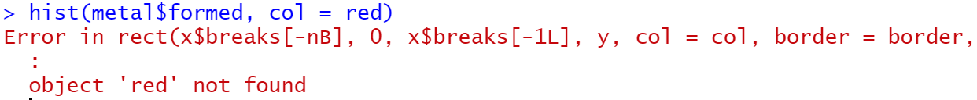
Common Mistakes in This Lab
No Quotes When You Need Quotes
Symptoms include:
“object not found” error
Function will not run
Other functions are not impacted
Colors and many other argument inputs are characters, and need to be surrounded by quotations so that R doesn’t think they are an object.
Treatment:
It tells you the object that isn’t found – go and look to see if that needs to have quotations on it.

Slide 10

Lab 2 EXTRA CREDIT!!
UGLY/BEAUTIFUL PLOT COMPETITION
Follow directions at the end of the lab to make a very ugly plot and submit it to your discussion board by Friday at 6:00pm.
Make sure to clarify which it is, you’d be surprised how different all our aesthetics are

Slide 11
Lab 2 Vocabulary Review
R Vocabulary
R Code
Argument: an “adjective” in R that helps you modify code, like adding color to a plot
Blue Plus Sign of Death: a plus sign that shows up in the console, often when you have an unpaired quotation or parentheses
Character: something in R that isn’t an object, and needs to be contained by quotation marks
Bin: the bars in a histogram
Univariate: one variable is involved, like in a histogram
Bivariate: two variables are involved, like in a scatterplot
Tilde: The word for this symbol: ~
plot() – a code to make a scatterplot’
This lab teaches you many different arguments for basic plotting in R, including color modifications, labels, titles, etc.
Optional:
abline() – adds vertical, horizontal, or angled lines
text() – adds text to plots

